Slide 1
C Turing machine JERRY CAI

Slide 2
AGENDA
DOCUMENTATION
DIAGRAMS
CODE

Slide 3
THE PROBLEM
DESCRIBE:
Halting problem - asks whether you can write a program that can predict if another program will freeze or not.
PROCESS:
Create the standards are practices for the code itself.
Create some sort of diagram to help me depict what the actual program might look like.
Implement the diagram and use it to create the turing machine in C

Slide 4
EXPECTED DELIVARABLES
DOCUMENTATION / DESIGN
CODE
Design that comes with the program that would help the user better understand the system.
Documentation that comes with the program that would help the user better understand the system.
A fully operational codebase that serves as a basic Turing machine.
Language acceptor that takes the user input and tells the user whether the input works with the language.

Slide 5
CODE STANDARDS AND PRACTICES
◆ Every procedural program or driver must use a main method.
◆ Main methods must be at the top of your code file.
◆ Global variables are unacceptable.
◆ Programs should be broken into functions where possible.
◆ Functions should have less than 20 lines if possible.
◆ All functions should be well defined.
◆ All function should be testable.
◆ All code should be self-documenting.
◆ Conventional Data Structure designs must be used if possible.
◆ Submissions should have no compiler or interpreter errors.

Slide 6
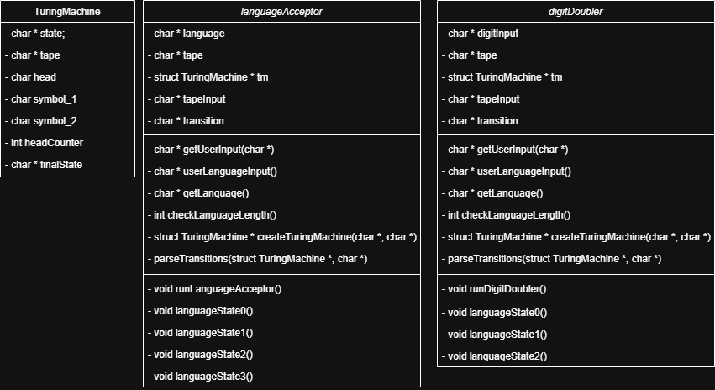
UML DIAGRAM

Slide 7
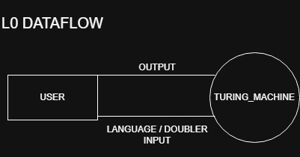
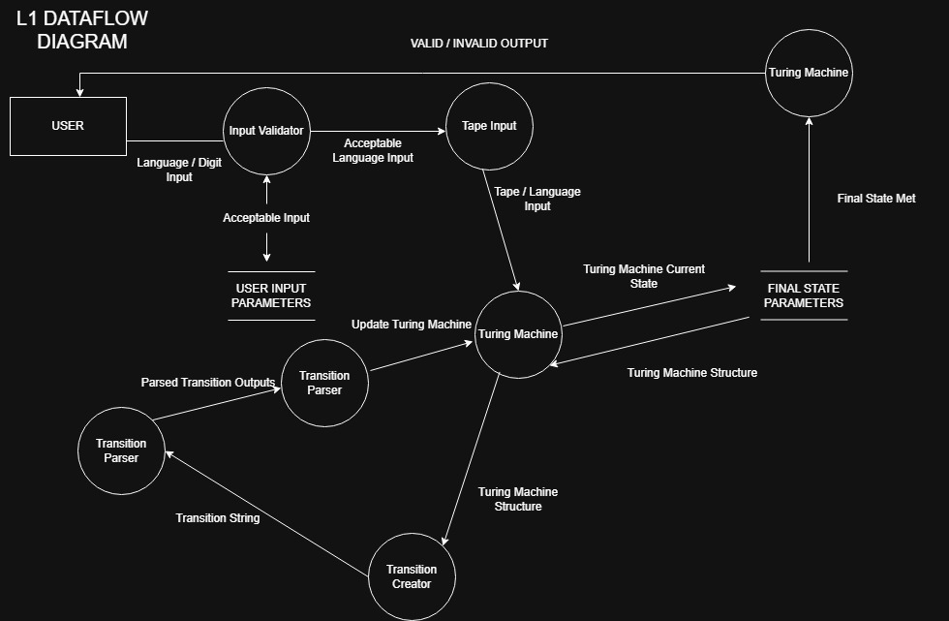
Dataflow Diagrams

Slide 8
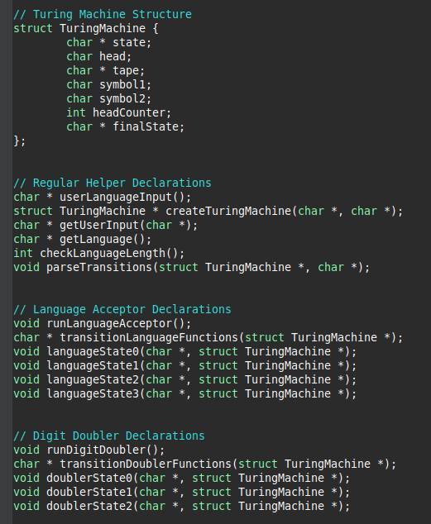
CODE - DECLARATIONS

Slide 9
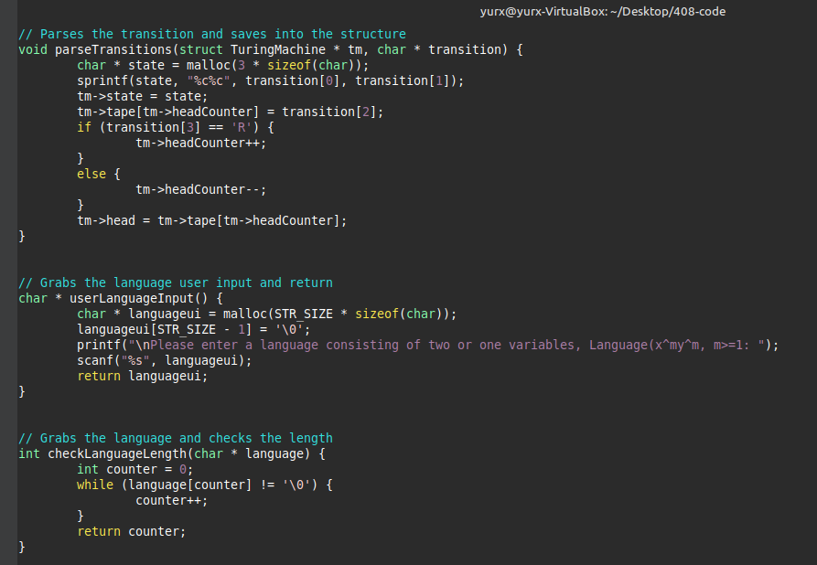
CODE - HELPERS

Slide 10
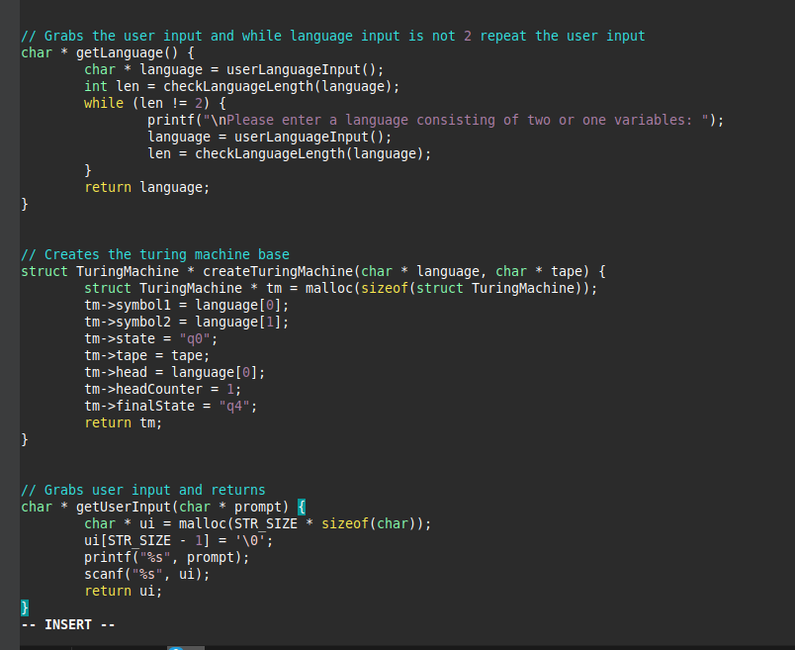
CODE - HELPERS

Slide 11
CODE - HELPERS

Slide 12
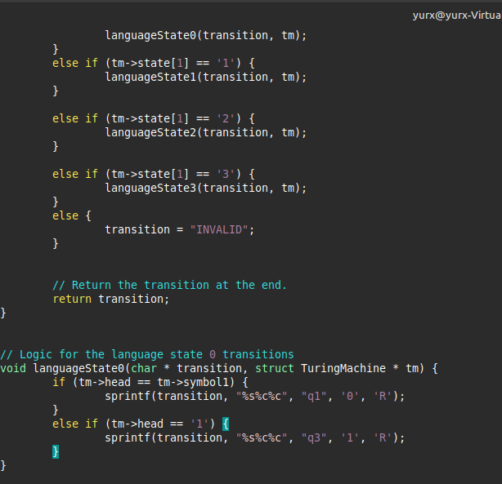
CODE - TRANSITION

Slide 13
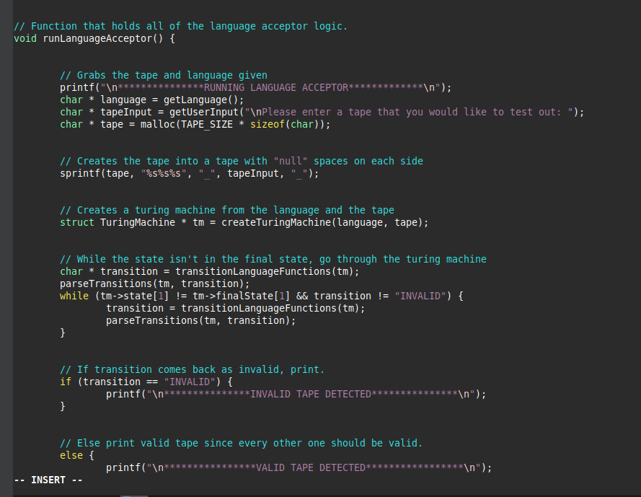
CODE - RUN

